Slide 1
Java Plays :
Introduction to Database Services
IBM
ECOD

Slide 2
Agenda
Purpose of This Section
Cloudant NoSQL Service provides JSON document based DB service that is invoked using RESTful APIs using document id or MapReduce function views
dashDB provides in-memory columnar database Optimized for accelerated analytics
SQL Database provides relational database service to handle highly transactional workloads.
Time Series Database provides massive time series data storage with optimized query performance and simplicity
Summary
Java Plays : Introduction to Database Services

Slide 3
Purpose of this section
In this section, we will introduce key database services and high level features available in Bluemix
including Cloudant NoSQLDB, dashDB, SQL Database, and Time Series Database.
Java Plays : Introduction to Database Services

Slide 4

Cloudant NoSQL Service provides JSON document based DB service that is
invoked using RESTful APIs using document id or MapReduce function views.
What is Cloudant NOSQL Service?
A fully managed NoSQL Database as a Service
Transactional JSON document database with
Restful API
Support of distributed data across data centers
& devices
Ideal for apps that require:
  Massive, elastic scalability
  High availability
  Geo-location services
  Full-text search
Java Plays : Introduction to Database Services

Slide 5
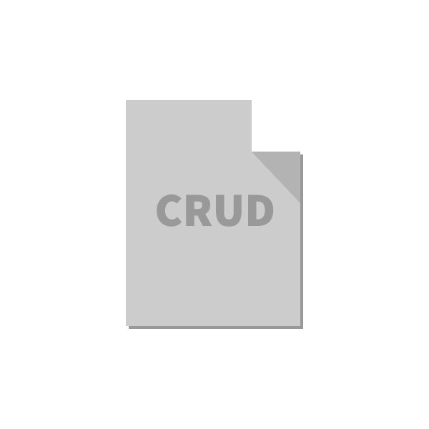
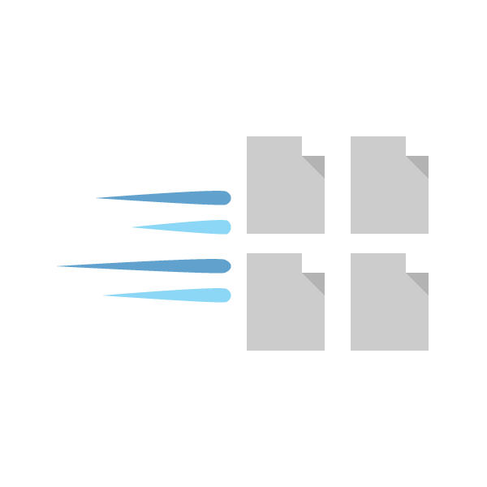
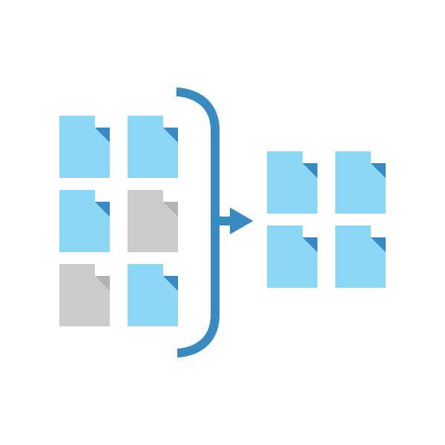
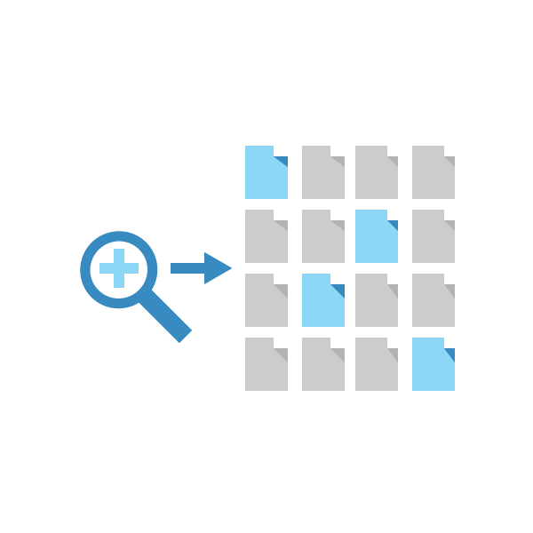
Cloudant API Feature HIghlights
JSON Documents | Primary Index | Secondary Indexes | Search
Create Read Update Delete | Exists for every database “OOTB” Find docs by their primary key → _id | Built using MapReduce Use when you need to analyze data Ex: count data fields, aggregate/sum results, etc. | Built using Lucene Ad-hoc queries Find documents based on their contents
Notes:
The Cloudant API can be divided into 4 areas:
CRUD – For managing the lifecycle of documents (create, read, update and delete)
Primary Index – Find documents by their primary key
Secondary indexes – Return subset of data and/or provide aggregation
Search – Enhanced search for documents containing search keys

Slide 6
Cloudant Synch
Native replication feature that allows you to push database access to mobile devices, remote facilities, sensors, and Internet-enabled devices
Enables mobile and distributed apps to scale by replicating and syncing data between multiple readable, writable copies of a database even on mobile iOS and Android devices
Simplifies large-scale mobile development by enabling you to create a single local database for every user.
  Reduces round-trip database requests with the server because when there is no network connection, the app runs off the database on the device.
  When the network is restored local data is synced with server
Notes:
Managing user, machine, and environmental data for massive networks of mobile users or remote devices can be a scalability and availability nightmare. The problem is that most databases require updates to occur in a central, “master” database. This can result in performance bottlenecks and also prevent client apps from running if the connection to the master database is unavailable.
Cloudant Sync enables you to push database access to the farthest edge of the network —mobile devices, remote facilities, sensors, and internet-enabled goods, so that you can:
Scale bigger
Enable client apps to continue running off-line
Cloudant Sync allows mobile and distributed apps to scale by replicating and synching data between multiple readable, writeable copies of the data in other data centers, and even on mobile iOS and Android devices. This is much easier and more cost efficient than growing a single, central database to handle all data collection.
Cloudant Sync simplifies large-scale mobile development by enabling you to create a single database for every user; you simply replicate and sync the copy of this database in Cloudant with a local copy on their phone or tablet (or vehicle, sensor, appliance, etc.). This can reduce round-trip database requests with the server. If there’s no network connection, the app runs off the database on the device; when the network connection is restored, Cloudant re-syncs the device and server. Some of Cloudant’s largest mobile developers, have scaled into the millions of databases.

Slide 7
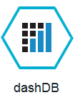
dashDB provides in-memory columnar database
Optimized for accelerated analytics
Service | Use Case | Free Tier (30-day) Sizing | Entitled (Paid) Sizing
dashDB | Data warehousing and accelerated analytics | Includes perpetual free tier up to 1 GB stored data | Up to 20GB (Entry ) Dedicated instances from 64GB up to 256GB of data
Stores relational data for querying and advanced analytics
  Data mining
  Predictive Analytics
  Geospatial Analytics
Powered by IBM BLU Acceleration and Netezza in-Database Analytics
  IBM BLU Acceleration is fast and simple. It uses dynamic in-memory columnar technology and innovations such as actionable compression to rapidly scan and return relevant data.
  In-database analytic algorithms integrated from Netezza bring simplicity and performance to advanced analytics.
Notes:
Use dashDB to store relational data, including special types such as geospatial data. Then analyze that data with SQL or advanced built-in analytics like predictive analytics and data mining, analytics with R, and geospatial analytics. You can leverage the in-memory database technology to use both columnar and row-based tables. The dashDB web console handles common data management tasks, such as loading data, and analytics tasks like running queries and R scripts.
You can also connect external applications and tools to dashDB and use them to further manage or analyze your data. For example: Connect IBM® InfoSphere® Data Architect to design and deploy your database schema.
Connect Esri ArcGIS to perform geospatial analytics and map publishing with your data.
Connect an IBM Cognos® server to run Cognos reports against your data.
Connect SQL-based tools such as Tableau, Microstrategy, or Microsoft Excel to manipulate or analyze your data.
Connect your Bluemix™ applications that need an analytics database.
Connect Aginity Workbench to migrate Netezza® data models and data to dashDB.

Slide 8
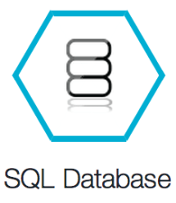
SQL Database provides relational database service to
handle highly transactional workloads.
Service | Use Case | Free Tier (30-day) Sizing | Entitled (Paid) Sizing
SQL Database | Web, transactional | Includes perpetual free tier up to 100MB stored data | Small - 10 GB per instance Premium – 500GB per instance
On-demand relational database powered by DB2.
Provides a managed database service to handle web and transactional workloads
Offers high availability, automated backups and data privacy.
Notes:
SQL Database adds an on-demand relational database for applications ruining on IBM Bluemix. . Powered by DB2, it provides a managed database service to handle web and transactional workload offering high availability, automated backups and data privacy.

Slide 9
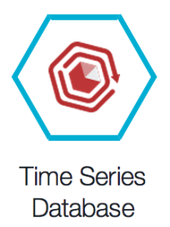
Time Series Database provides massive time series data storage with optimized
query performance and simplicty
Service | Use Case | Free Tier (30-day) Sizing | Entitled (Paid) Sizing
Time Series Database | Internet of Things | Includes perpetual free tier up to 1 GB stored data | 10 GB stored data per instance
Highly efficient storage, lowering costs for storing massive amounts
of time series data in the cloud
Time Series functions (extended SQL) make writing applications much simpler than standard SQL, faster iteration
Time Series offered alongside a fully functional, enterprise-class relational database framework (Informix)
  Support for both SQL and NoSQL (JSON) within the same database
  Allows for data movement between the two interfaces
Notes:
IBM Time Series Database for Bluemix service is a managed data store for Internet of Things device data, The Time Series database service supports multiple methods for applications to access it to store, update, and query the data in a Time Series Database including the MongoDB APIs, a REST API, the IoT REST API, and the IBM Informix JDBC API.
Time Series Database is ideal for clients with large amounts of time series data, such as data generated or collected by many “edge devices”. Furthermore, it is well-suited in financial trading markets for use as a data repository, which can offer built-in functionality for supporting time series data. Time Series Database is positioned for clients who need location data. Alternatively, it can appeal to customers needing both SQL and NoSQL storage solutions, and would prefer them in a single package for consumption. For clients who required a highly reliable database service that is still easy to get started with, easy to use, free to play with, and inexpensive to start with– but capable of scaling to handle the largest loads –Time Series Database is an attractive piece of the Data Services portfolio on Bluemix.

Slide 10
Summary
After this session, you should be aware of key database as services provided via Bluemix and
their high level capabilities.
Java Plays : Introduction to Database Services

Slide 11
This ends Introduction to Database Services.
Thank you !
Java Plays : Introduction to Database Services

